Slide 1

Module 2
Exploratory Data Analysis (EDA)
Notes:
Guidelines
Use section headers to chunk content in your presentation.
Use the same style of section header throughout your presentation.
Keep your title to no more than 2 lines.

Slide 2

EDA – Missing Values, Transformations
Notes:
Guidelines
Use a title slide at the beginning of your presentation. There are 9 variations of title slides to choose from.
If you will have a series of slideshows, we recommend using the same style of title slide for each presentation.
Keep your title to no more than 2 lines.
Do not change the font style or font size of the title or subtitle.

Slide 3
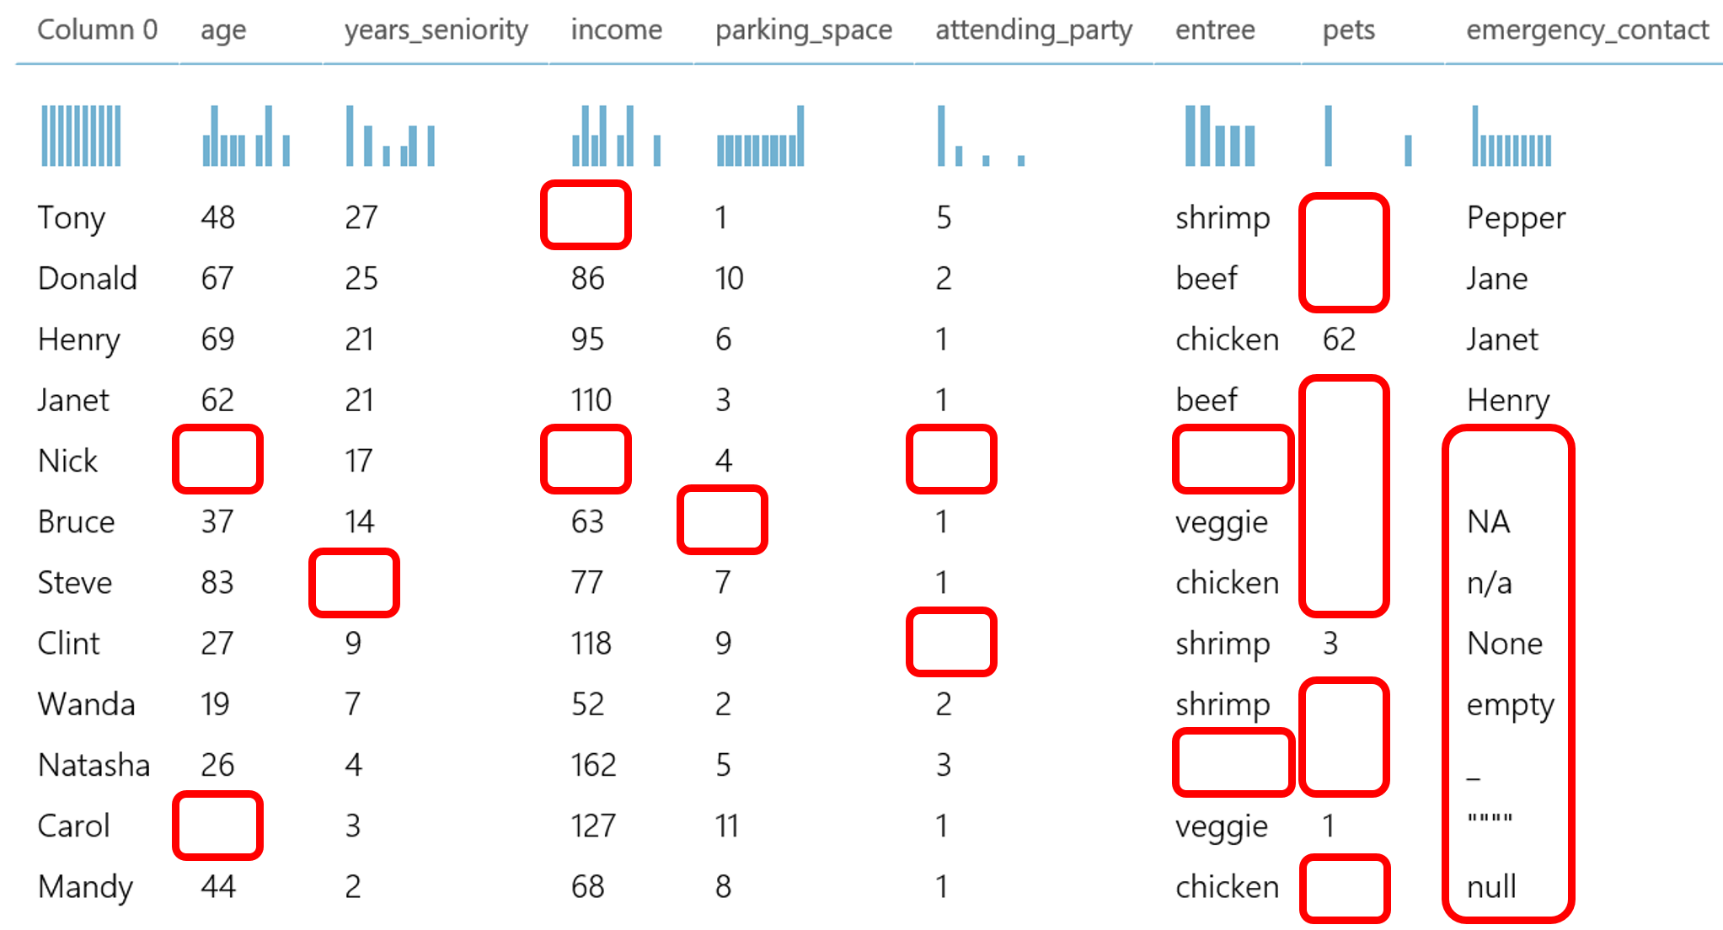
Missing Values
Missing values can be problematic with any model
Models generally assume no missing values in any variable

Slide 4
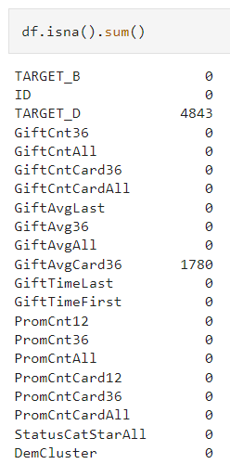
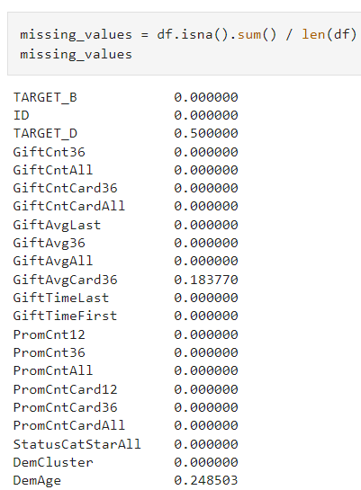
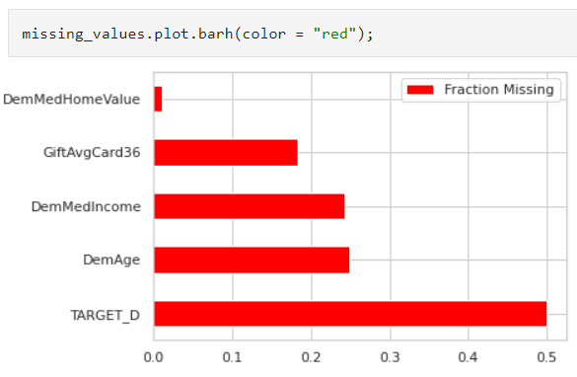
Checking for Missing Values
It is important to get a summary of missing values per variable

Slide 5
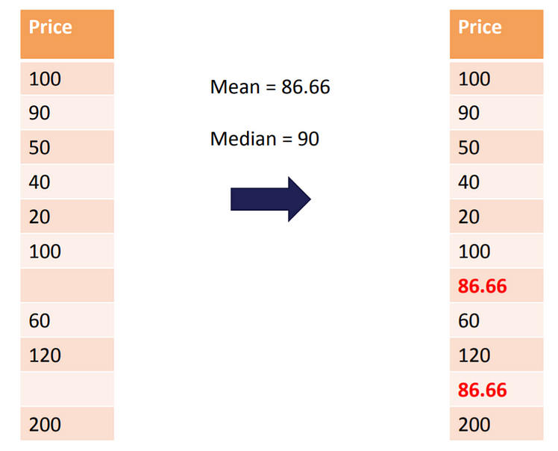
Imputation of Numeric Variables
Imputing means replacing missing value with an estimate
Common numeric estimates are the mean and median
Mean Imputation
Median Imputation
Model-Based Imputation

Slide 6
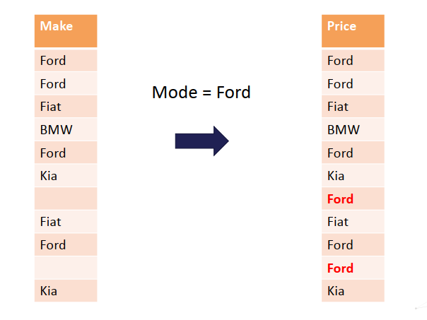
Imputation of Categorical Variables
Categorical variables can be imputed with the mode or new level
Mode Imputation
Imputing with new level “missing”

Slide 7
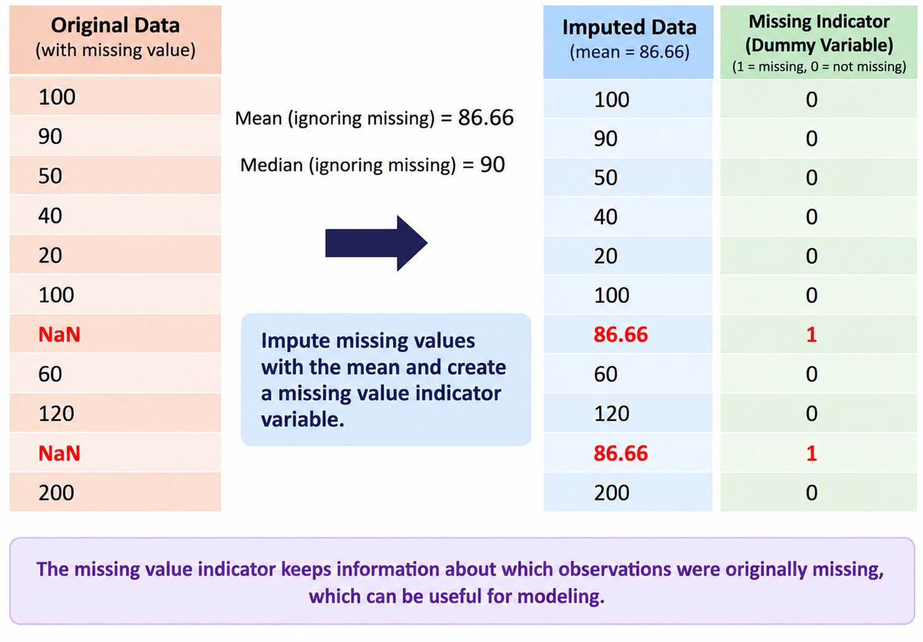
Missing Value Indicator Variables
It is a dummy variable {0,1} that shows when missing imputed

Slide 8
Python
Notes:
Guidelines
Use a title slide at the beginning of your presentation. There are 9 variations of title slides to choose from.
If you will have a series of slideshows, we recommend using the same style of title slide for each presentation.
Keep your title to no more than 2 lines.
Do not change the font style or font size of the title or subtitle.

Slide 9
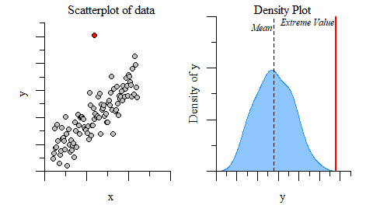
Unusual Values
Unusual values and outliers affect model performance
We should check for these in EDA

Slide 10
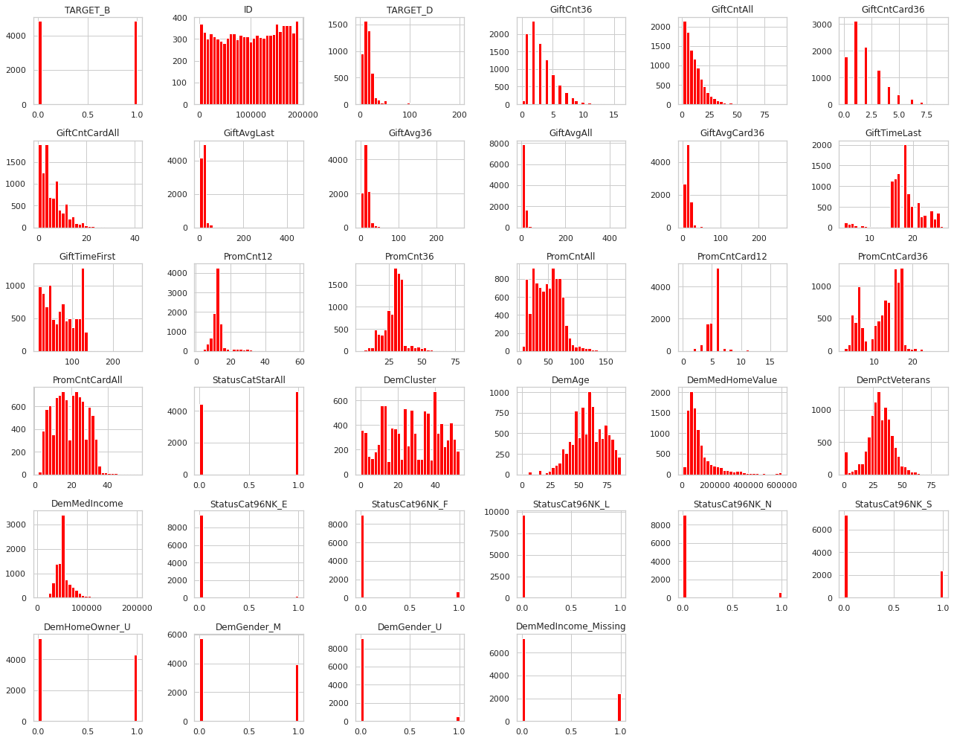
Unusual Values

Slide 11
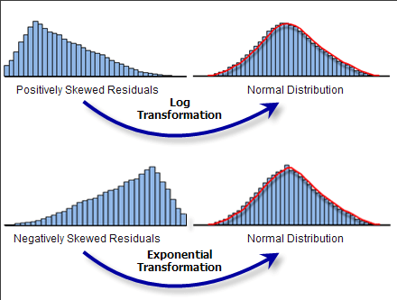
Transformations
A way to make the data work better in your model
Particularly helpful in logistic regression and neural networks

Slide 12
Python
Notes:
Guidelines
Use a title slide at the beginning of your presentation. There are 9 variations of title slides to choose from.
If you will have a series of slideshows, we recommend using the same style of title slide for each presentation.
Keep your title to no more than 2 lines.
Do not change the font style or font size of the title or subtitle.

Slide 13
Module 2
Exploratory Data Analysis (EDA)
Notes:
Guidelines
Use section headers to chunk content in your presentation.
Use the same style of section header throughout your presentation.
Keep your title to no more than 2 lines.

Slide 14

EDA – Encoding Categorical Variables
Notes:
Guidelines
Use a title slide at the beginning of your presentation. There are 9 variations of title slides to choose from.
If you will have a series of slideshows, we recommend using the same style of title slide for each presentation.
Keep your title to no more than 2 lines.
Do not change the font style or font size of the title or subtitle.

Slide 15
Encoding Categorical Variables
We have to encode categorical variables
Before building models all variables must be numerically encoded
We need to fix first incorrect variable types

Slide 16
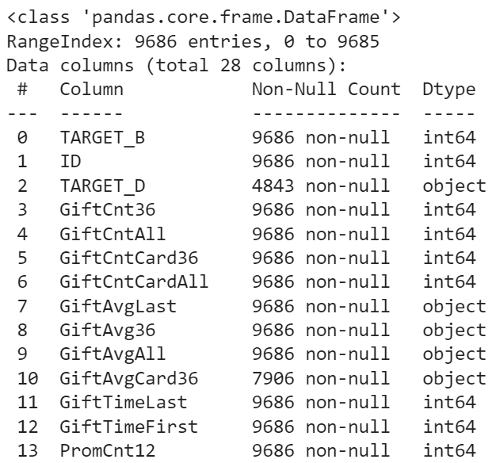
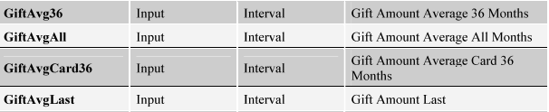
Encoding Categorical Variables
Which variables are incorrect types (if any)?
Object to Float

Slide 17
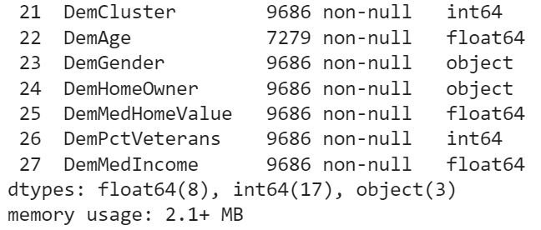
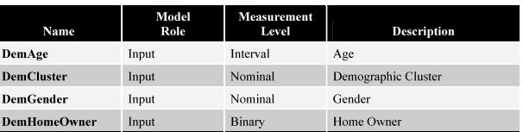
Encoding Categorical Variables
Which variables are incorrect types (if any)?
Int64 to object

Slide 18
Python
Notes:
Guidelines
Use a title slide at the beginning of your presentation. There are 9 variations of title slides to choose from.
If you will have a series of slideshows, we recommend using the same style of title slide for each presentation.
Keep your title to no more than 2 lines.
Do not change the font style or font size of the title or subtitle.

Slide 19
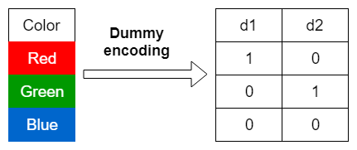
Dummy-Encoding
Used when the number of levels is not excessive
The pd.get_dummies() function is useful
  drop_first = True

Slide 20
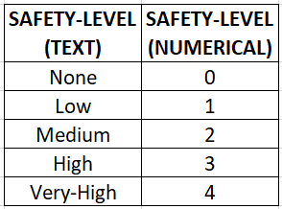
Label-Encoding
Used for ordinal-type variables
Used for categorical variables with many levels

Slide 21
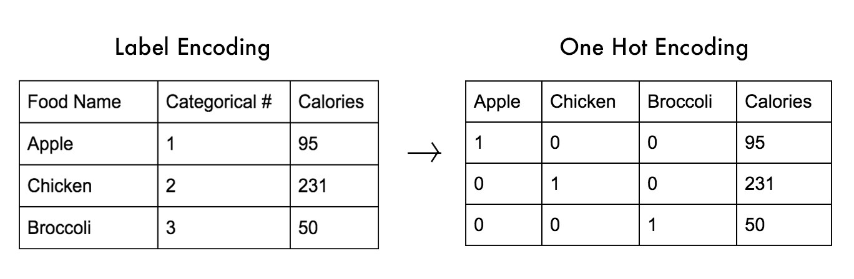
One-Hot Encoding
Similar to dummy-encoding
Used to indicate presence/absence of levels
Popular in Neural Networks

Slide 22
Python
Notes:
Guidelines
Use a title slide at the beginning of your presentation. There are 9 variations of title slides to choose from.
If you will have a series of slideshows, we recommend using the same style of title slide for each presentation.
Keep your title to no more than 2 lines.
Do not change the font style or font size of the title or subtitle.

Slide 23
Module 2
Exploratory Data Analysis (EDA)
Notes:
Guidelines
Use section headers to chunk content in your presentation.
Use the same style of section header throughout your presentation.
Keep your title to no more than 2 lines.

Slide 24

EDA – Unstructured Data
Notes:
Guidelines
Use a title slide at the beginning of your presentation. There are 9 variations of title slides to choose from.
If you will have a series of slideshows, we recommend using the same style of title slide for each presentation.
Keep your title to no more than 2 lines.
Do not change the font style or font size of the title or subtitle.

Slide 25
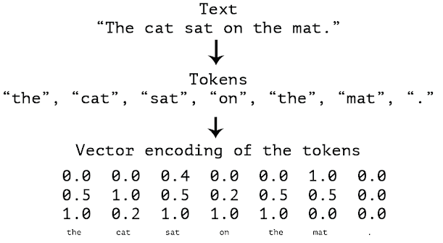
Text Data
We can encode text data into a vector representation
We call this vectorizing text
We convert the text into tokens (variables for our purpose)

Slide 26
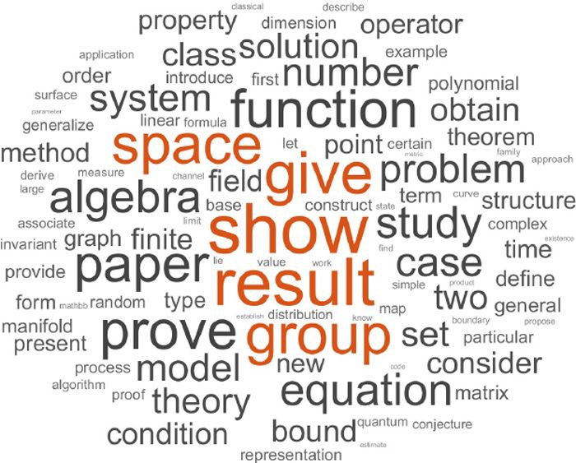
Text Data
Two of the main ways to vectorize text data are:
  Bag of Words
  Term Frequency

Slide 27
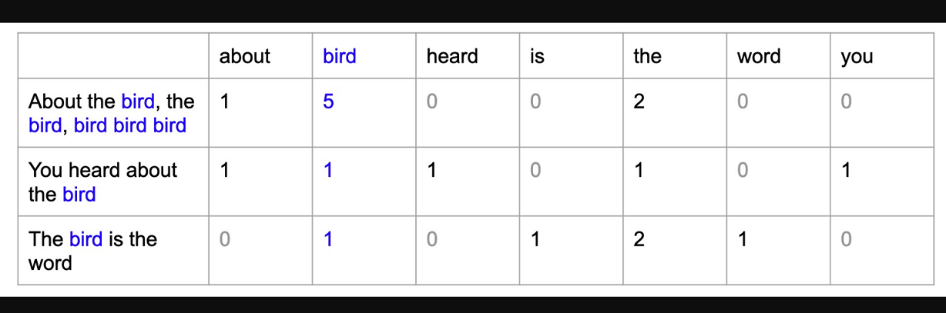
Bag of Words
We count the number of times a given word appears on the text.
We need to look at the corpus (all text) to determine all tokens

Slide 28
Python
Notes:
Guidelines
Use a title slide at the beginning of your presentation. There are 9 variations of title slides to choose from.
If you will have a series of slideshows, we recommend using the same style of title slide for each presentation.
Keep your title to no more than 2 lines.
Do not change the font style or font size of the title or subtitle.

Slide 29
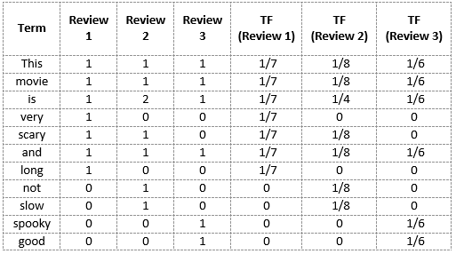
Term Frequency
We use the relative frequency of a word with respect to the document

Slide 30
Python
Notes:
Guidelines
Use a title slide at the beginning of your presentation. There are 9 variations of title slides to choose from.
If you will have a series of slideshows, we recommend using the same style of title slide for each presentation.
Keep your title to no more than 2 lines.
Do not change the font style or font size of the title or subtitle.

